Slide 1
Celebrating ODPs

Slide 2
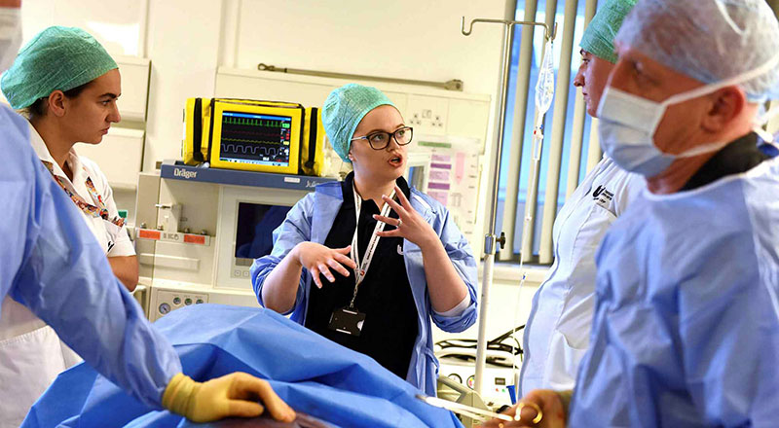
Thank you for all you have done... and for all you are doing
Thank you for all
you have done
and are doing

Slide 3
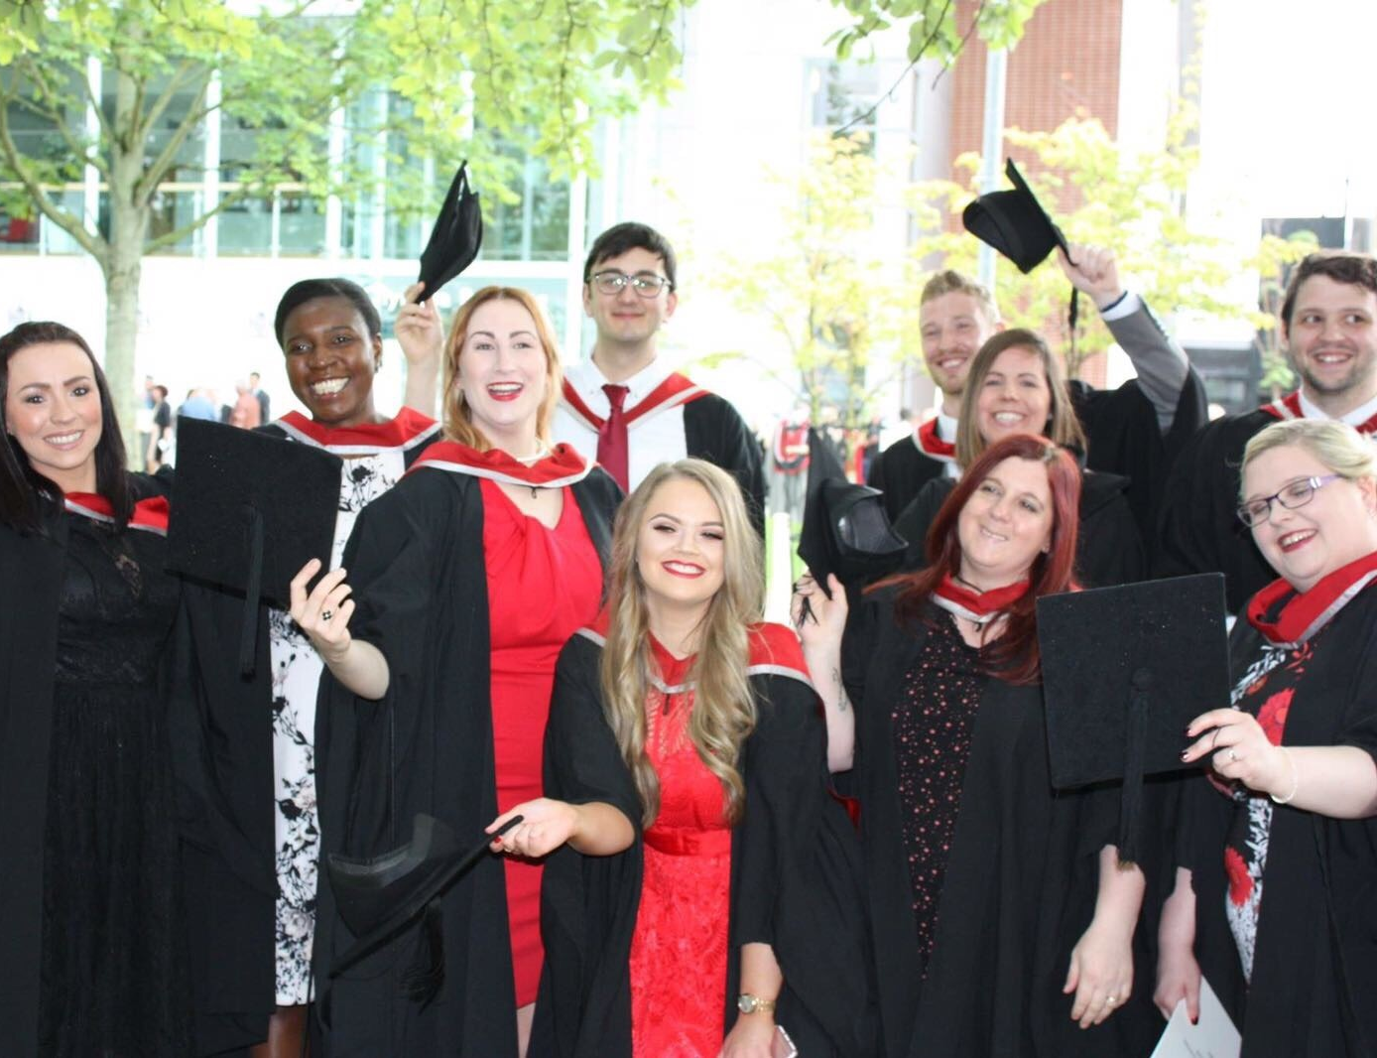
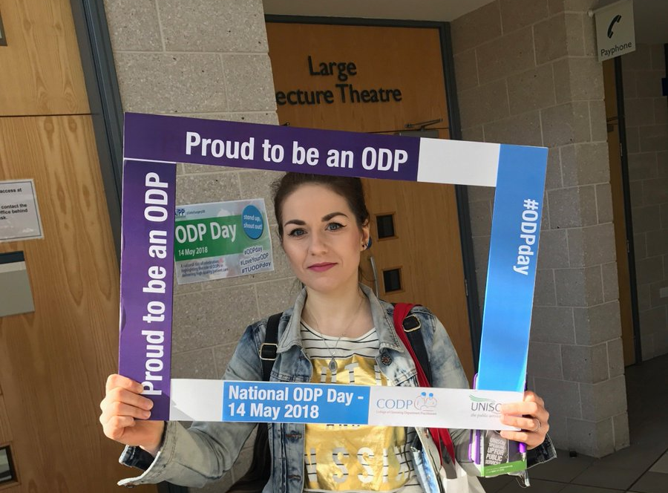
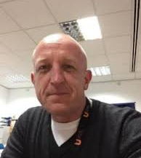
Proud of the ODPs we’ve trained
Proud to continue training

Slide 4
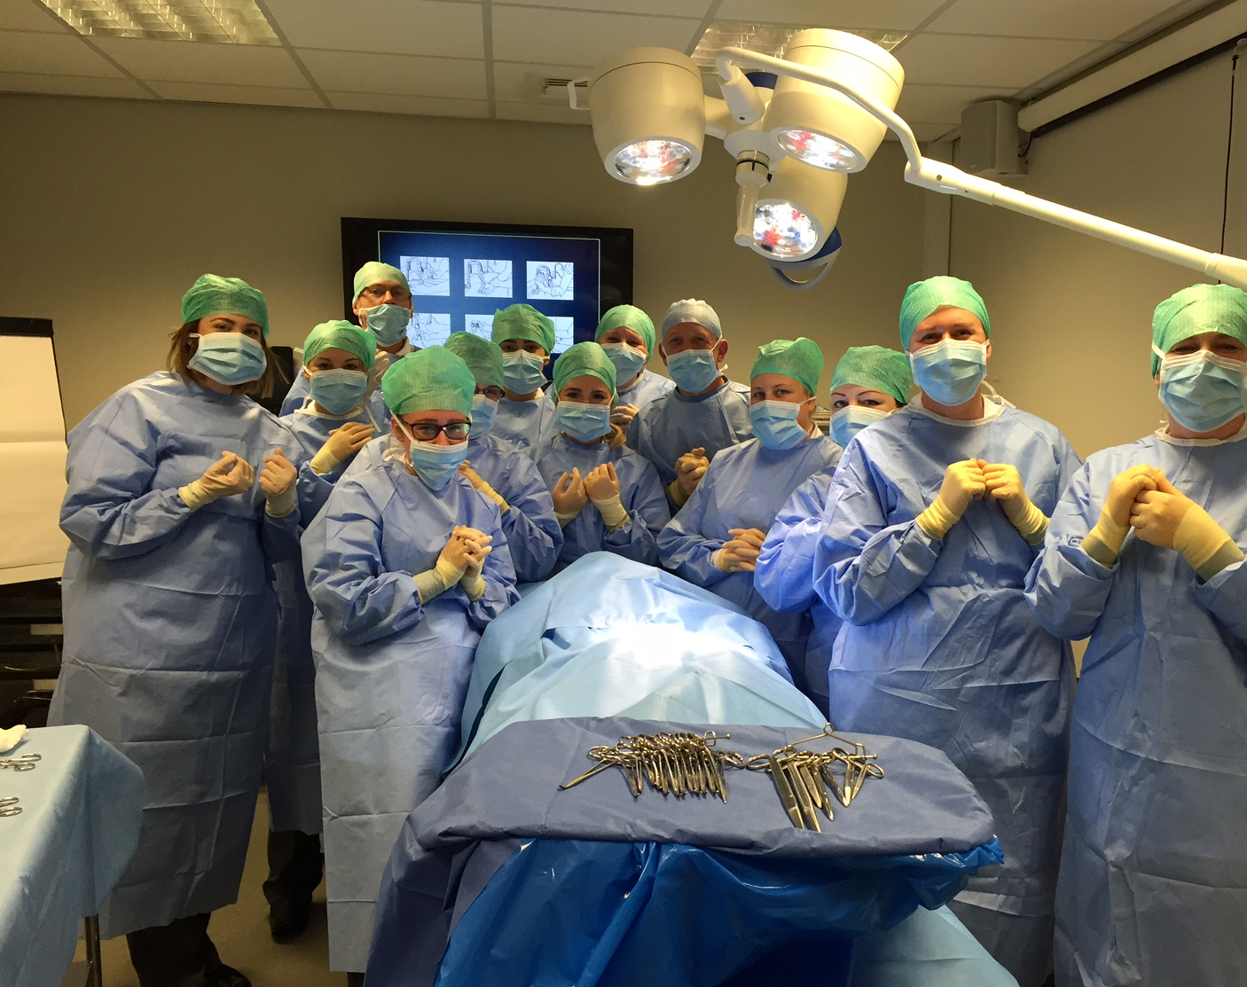
BSc (Hons) Operating Department Practice Studies​
​
Become one of the team

Slide 5
Celebrate
National ODP Day
Join us at 8.00pm on Thursday 14 May along with our ODPs and theatre teams by clapping to say thank you.

